Slide 1



TECHSAKSHAM CAPSTONE PROJECT
Project Title: Quiz App
Presented By:
D.Haritha – Dr.B.R.AU,Srikakulam(B.Tech-CSE)
R.Snehitha- Dr.B.R.AU,Srikakulam(B.Tech-CSE)
G.Satyavathi- Dr.B.R.AU,Srikakulam(B.Tech-CSE)
P.Devi- Dr.B.R.AU,Srikakulam(B.Tech-CSE)
Under the Esteemed Guidance of
UMAMAHESHWARI

Slide 2
Introduction:
We Have designed this app with the purpose of allowing software interested students to give exams and view their results.
Host can add questions into quiz from front end which are directly stored into database.
Finally after successful attempt score will be displayed, user can see the scorecard with respective name.

Slide 3
Problem Definition:
This React web quiz app that will provide a fun and engaging learning experience for users interested in computer science-related subjects. The app will offer a variety of quizzes covering topics such as programming languages, algorithms, data structures, and web development, among others. By providing a platform that combines education with entertainment, this app aims to help users improve their knowledge and skills in computer science.

Slide 4
Abstract:
This quiz app is a collection of number of quizzes based on different computer science related subjects. This app will start with login page, after entering login credentials by the user successfully home page will be displayed which contains dashboard and some other options like profile , scorecard, logout. Users can select a quiz to take, answer questions, and receive immediate feedback on their performance. The app also features a leaderboard that displays top scores, as well as the ability to create custom quizzes.This app is user friendly quiz which includes number of quizzes to related subjects,correct answers,immediate score and score card.
By this application the user will come to know about their level and can learn additional knowledge.

Slide 5

Software Requirements:
Front End | React, HTML, CSS, Javascript
Back End | PHP, SQL
Database Server | XAMPP server, MySql

Slide 6
Login/SignUp
Home
Subject
Play Quiz
Score

Slide 7
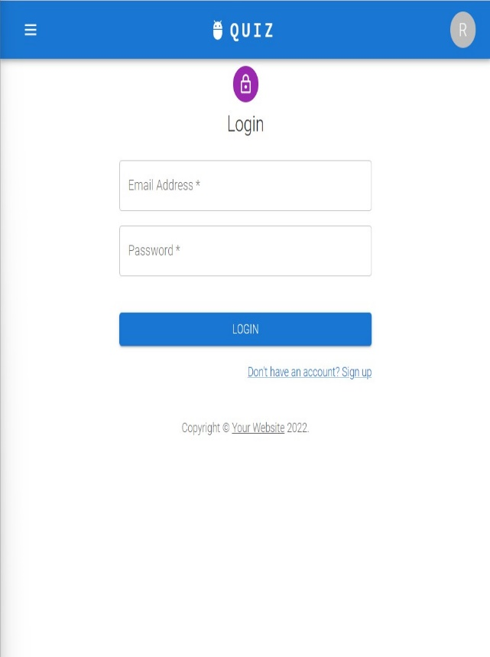
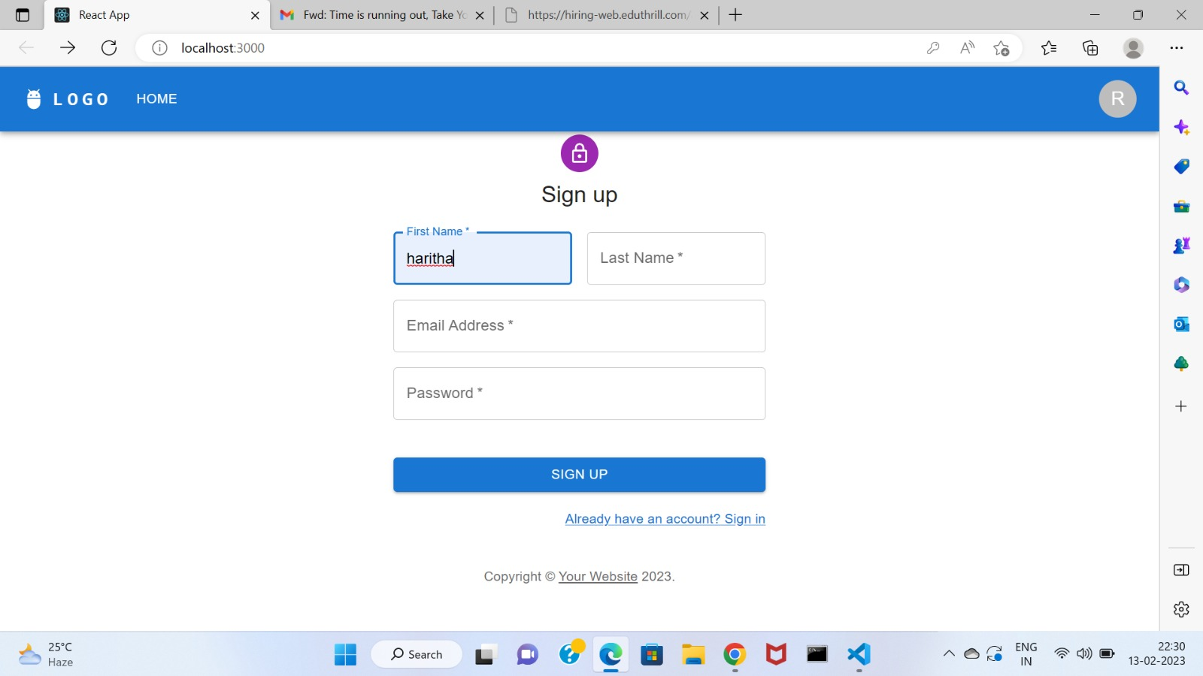
Output:

Slide 8
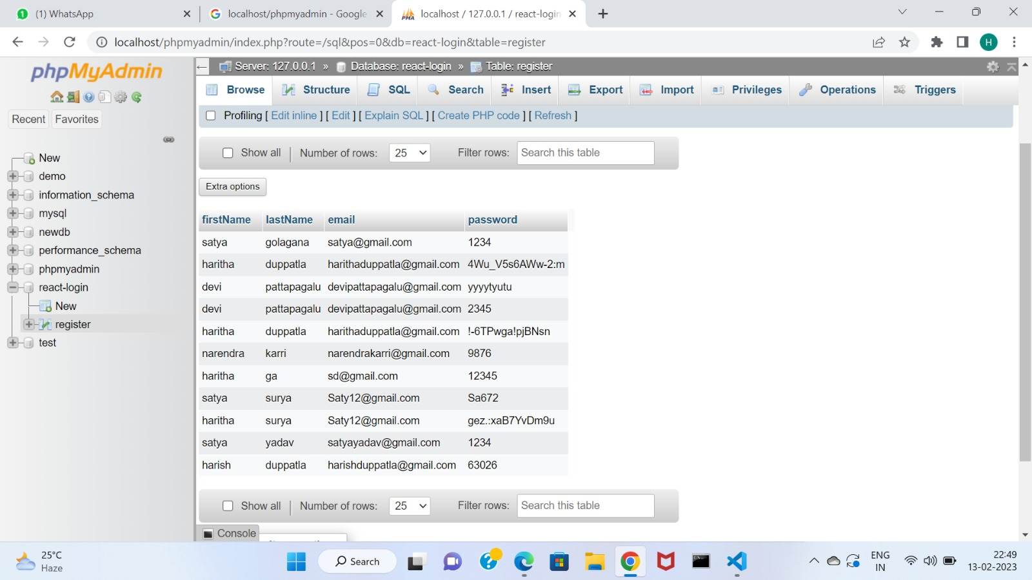
User’s Login Data:

Slide 9
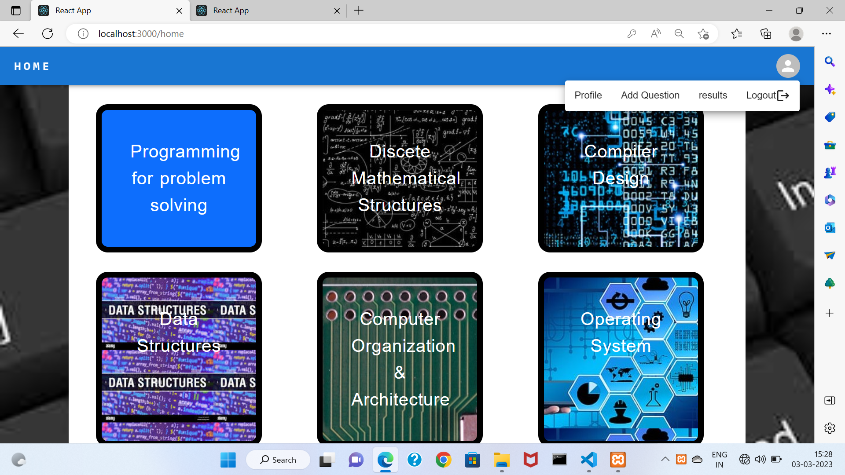
Dash Board:

Slide 10
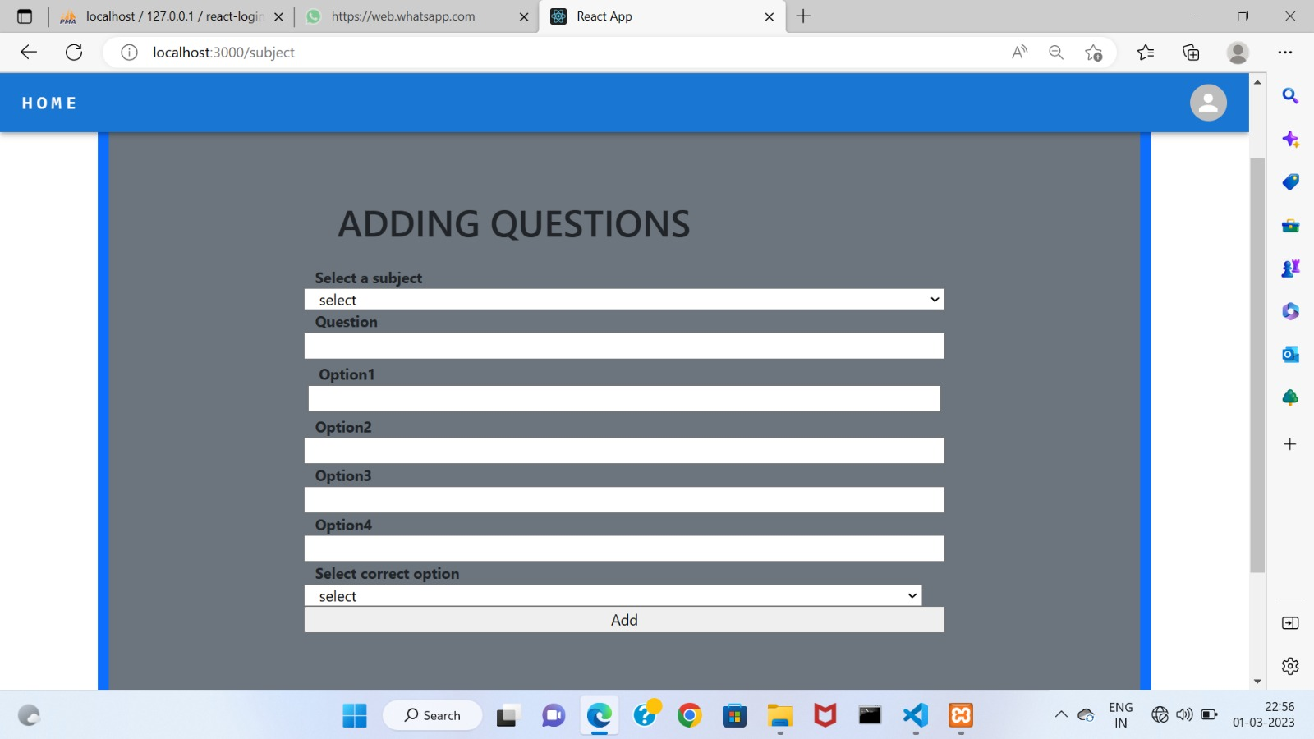
Adding Questions:

Slide 11
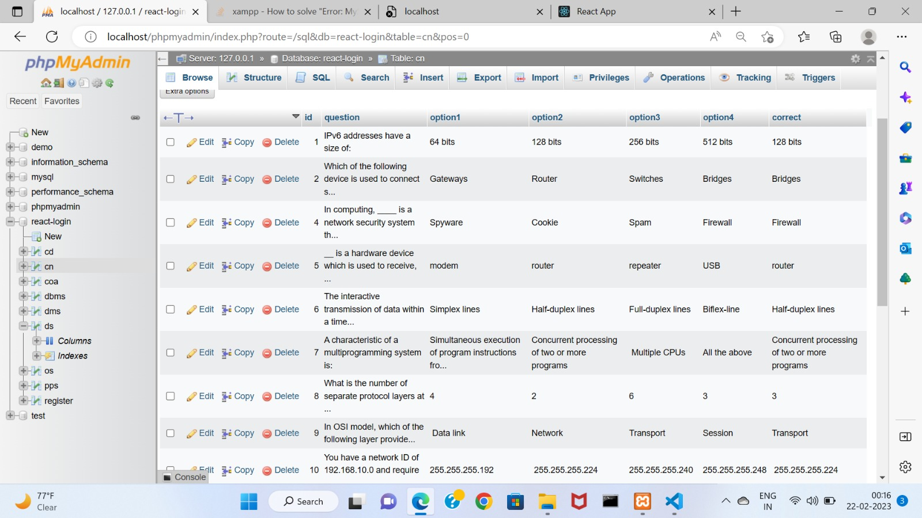
Question DataBase:

Slide 12
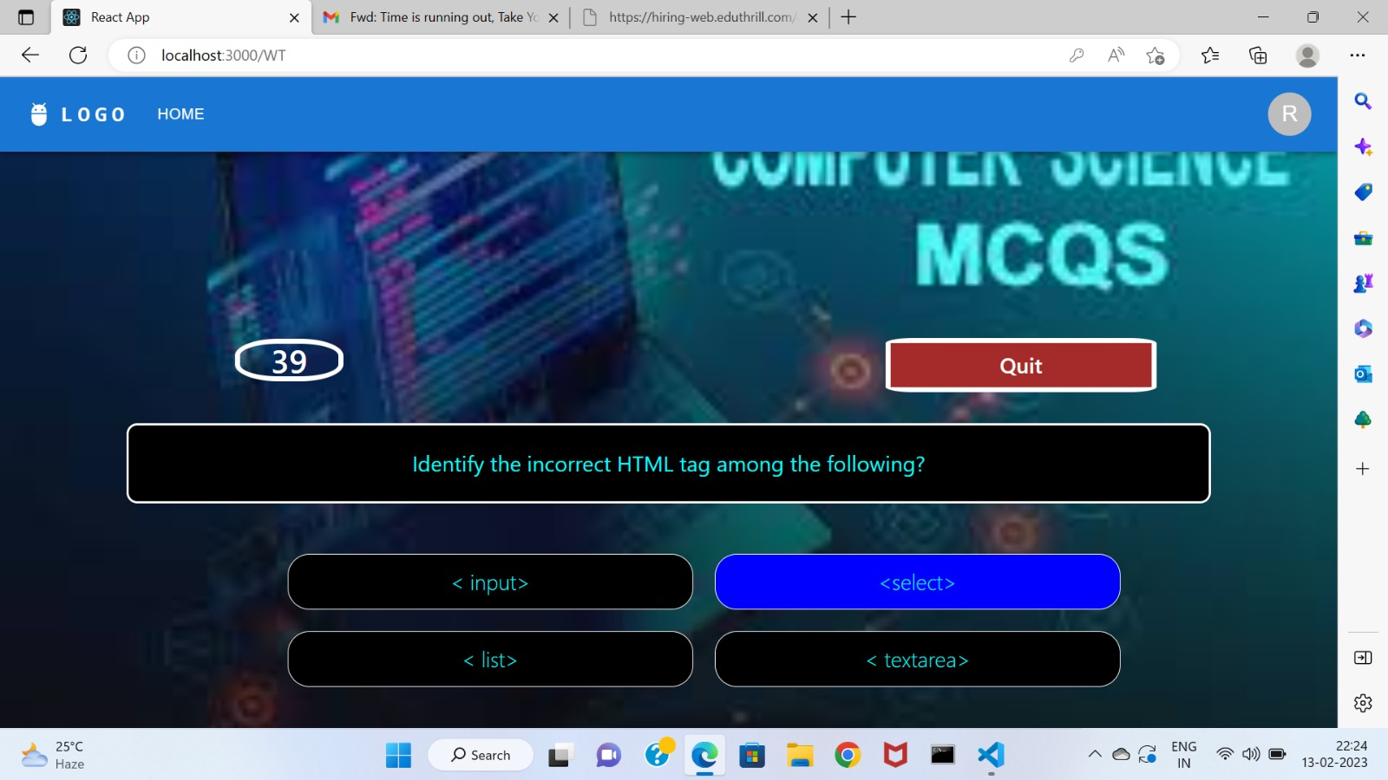
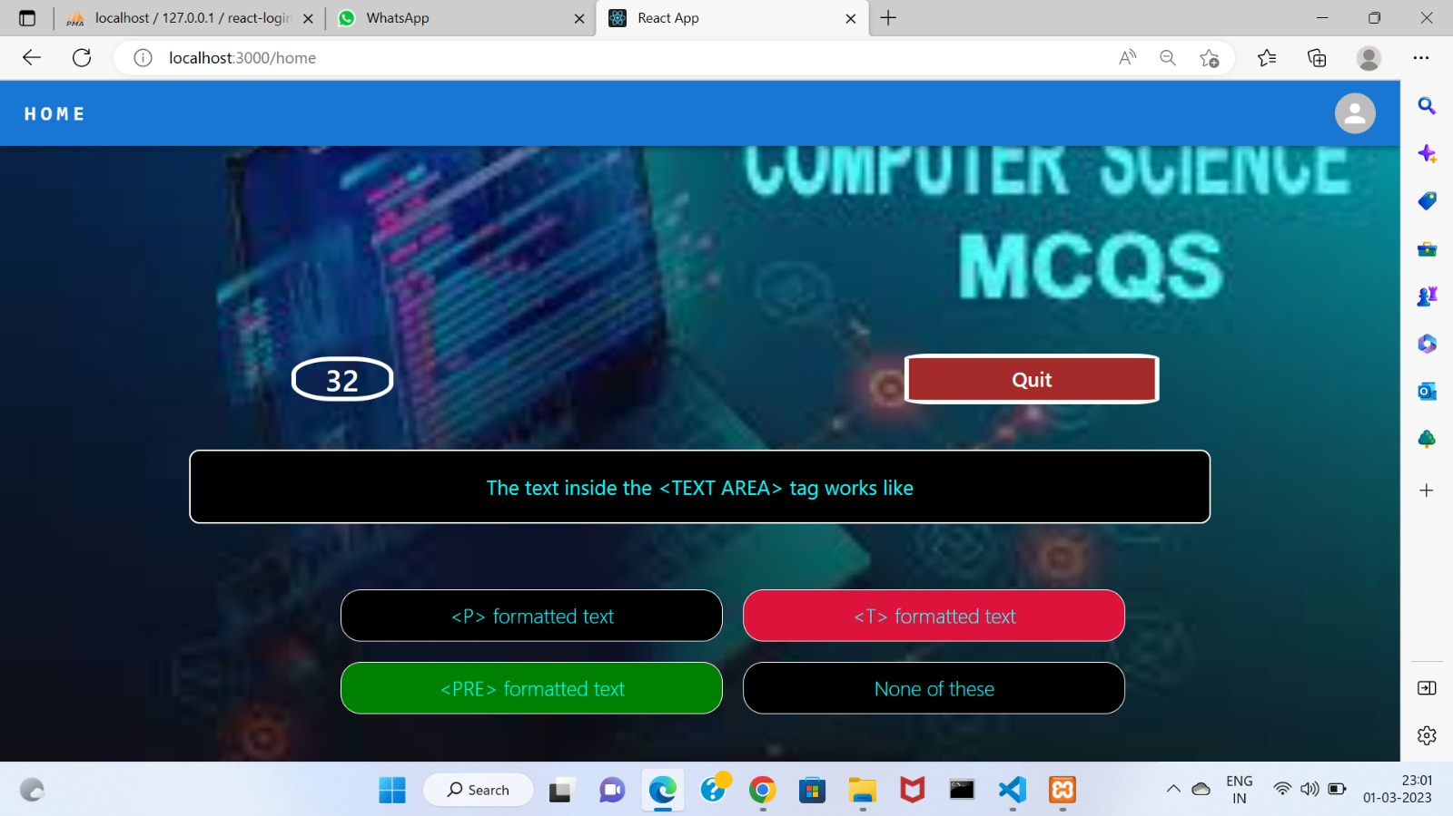
Quiz:

Slide 13
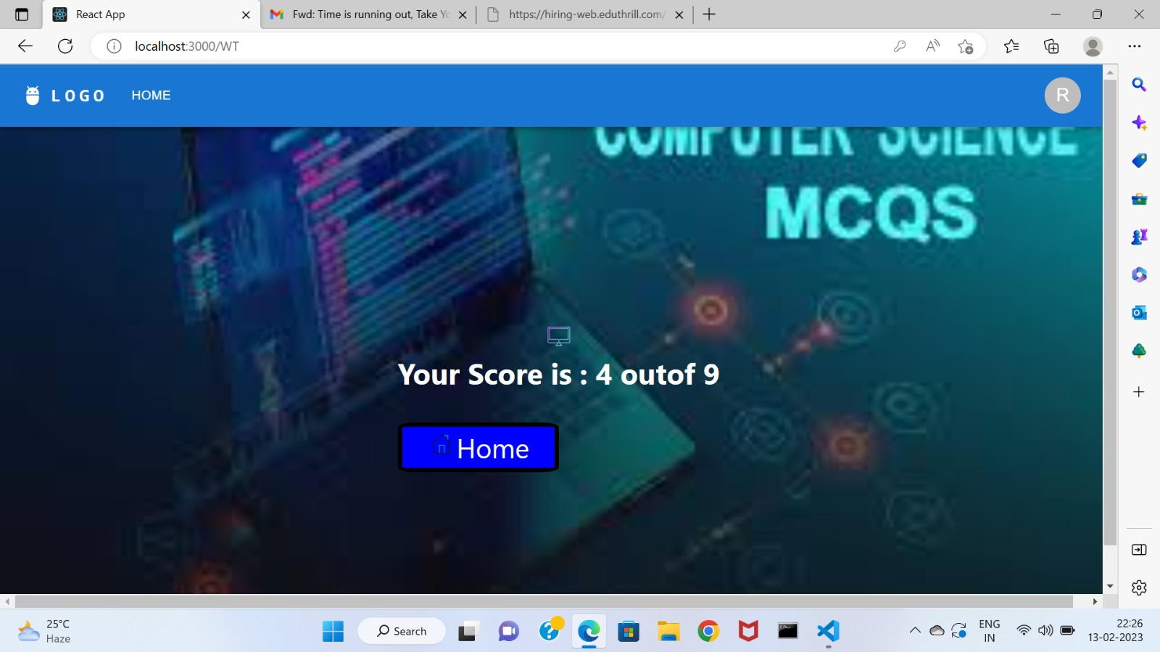
Score:

Slide 14
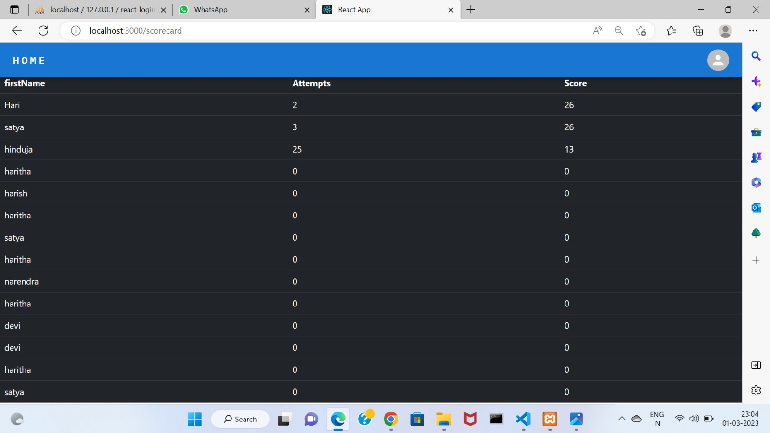
Score Card:

Slide 15
Conclusion:
The Key concept of this online quiz app is to minimize the amount of paper and convert the forms of documentation into digital form. This app made user learn more about particular subject for which user scored low marks. Then user can learn additional knowledge regarding that.

Slide 16
Thank You

